Slide 1


CLOUDY DATABASES
Ronald Bhuleskar Mohammed Abualrob
Kenneth Ko Srujan Vanama

Slide 2
Agenda
What is Cloud?
Why Shared Disk?
Do We Need Virtualization?
DBaaS?
Using Cloud Storage and Databases
Amazon Web Services
Security

Slide 3

CLOUD
Defined and Described

Slide 4
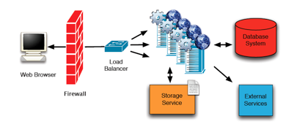
Cloud Web Architecture

Slide 5
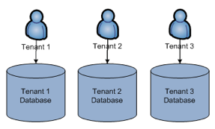
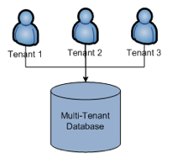
Multitenancy
Multi-tenant Schema
Single-tenant Schema

Slide 6
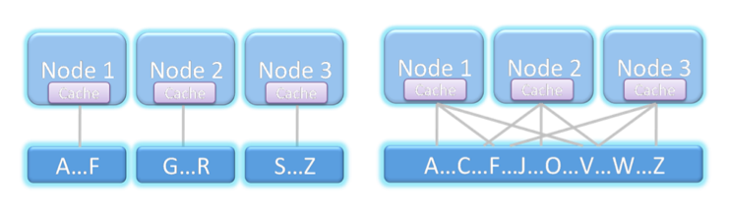
Shared Nothing, Shared Disk
Shared-Nothing
Shared-Disk
Notes:
Look at scale db
Don’t have fun

Slide 7
Features | Shared-Disk | Shared-Nothing
Load Balancing | Not bound to particular CPU | Not supported
High-Availability | Downtime reduced because no partitioning; Reroute of request to different servers | Repartitioning requires downtime
Data Consistency | Always consistent | Choice between performance and consistency
Parallel Processing | Effortless | Problematic
Scalability | Limited by messaging overhead between nodes; mitigated by elasticity | Impractical due to large data transfers between nodes
Elasticity | Add/remove nodes without impact to underlying data | Inefficient
Server Utilization | Requests redistributed—no CPU is idle | Requests bound to a specific server—not every server utilized
Operating Costs | Pay less for maintenance; pay more for Cloud-specific software | Human intervention with system increases costs

Slide 8


Slide 9
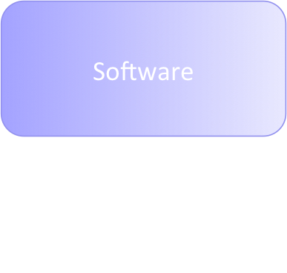
The Cloud
SalesForce
Gmail
Google AppEngine
Microsoft Azure
Amazon EC2, S3
GoGrid
Mosso
Platform
Infrastructure

Slide 10
Cloud Types
Category | Public Clouds | Private Clouds
Audience | General Public | Internal Employees
Advantages | Buy Less Hardware; Save Costs
 | Faster Deployment
Barriers to Entry | Security | Network Reconfiguration Costs
 | Early Adopters

Slide 11

VIRTUALIZATION
Uses in the Cloud

Slide 12
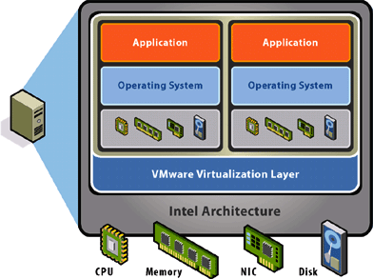
Virtualization
Runs on Full- or Thin-Operating System
Isolated Runtime Environment
Computing Asset Allocation
Dynamic Configurations
Pool Total Resources
VM Migration

Slide 13
Virtualization Woes
Inherently Slower
Reliant on Stability of Virtualization Layer
May Lose Hardware-specific Calls

Slide 14
Virtualization Providers
VMWare
Microsoft Hyper-V
Kernel Based Virtual Machine | KVM
VirtualBox
Xen

Slide 15
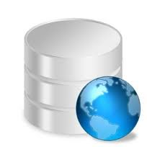
DATABASES
from the Cloud

Slide 16
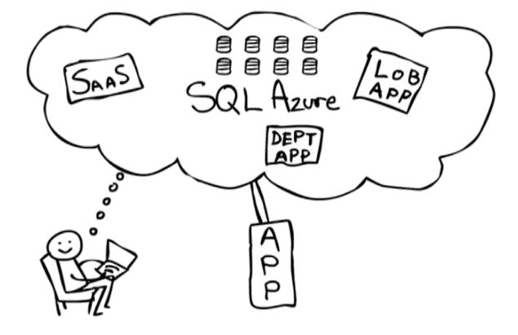
Database-as-a-Service

Slide 17
DBaaS Providers
Database.com by SalesForce
Dabble DB by Twitter
SQL Azure by Microsoft
ScaleDB
RDS by Amazon
Vertica for the Cloud

Slide 18
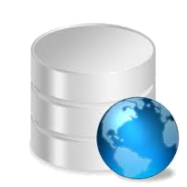

STORAGE AND DATABASES
in the Cloud

Slide 19
CAP Theorem
Can we get …
  Consistency
  Availability
  Network Partitioning
  … at the same time?

Slide 20
ACID vs. BASE
ACID
  Pessimistic
  Consistency vs. Availability
  Difficult to Provide for Cloud
BASE
  Optimistic
  Basically Available, Soft State, Eventually Consistent

Slide 21
Storage Solutions
Providers | Solutions
Amazon | Simple Storage Service Elastic Block Store
Box | Box Storage
Carbonite | Carbonite
EMC | Mozy
EVault | EVaultProtect
Microsoft | SkyDrive
Seagate | I365
Symantec | FileStore Storage Foundation VirtualStore

Slide 22
Compromises of DB in Cloud
No ACID Property
Transactions Not Supported
CAP Theorem Limitations

Slide 23
Internal Database Implementations
Service Provider | Internal Implementation
Amazon | Dynamo
Google | BigTable, Megastore
Microsoft | Microsoft SQL Server
Yahoo | Apache Hadoop
Facebook | Cassandra
Apache | CouchDB

Slide 24
Dynamo
Distributed Storage System
How does Dynamo work?
How does Dynamo compare?

Slide 25

AWS
Amazon Web Services

Slide 26
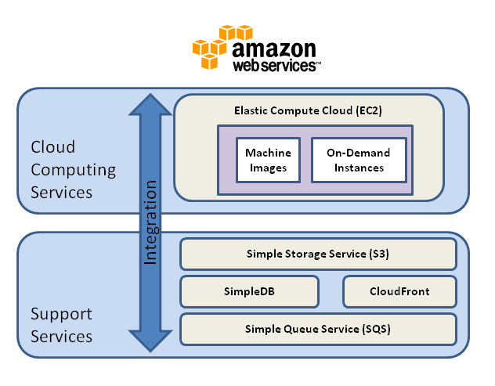

Slide 27
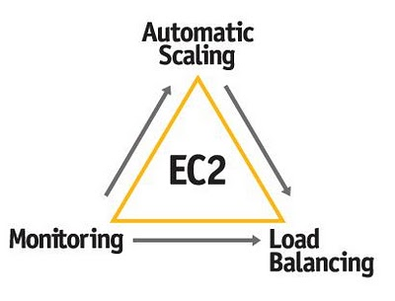
Elastic Compute Cloud (EC2)
Elastic
Completely Controlled
Flexible
Designed for use with AWS
Reliable
Secure
Inexpensive

Slide 28
Storage Services
Features | Simple Storage Service (S3) | Elastic Block Storage (EBS)
Accessibility Limitations | Any availability zone | Single EC2 instance, same availability zone
Block Sizes | 1 GB to 1 TB | 1 B to 5 TB
Consistency Model | Eventual consistency | Session consistency
Latency | Higher | Lower
Replication | Multiple datacenter | Single datacenter
Storage Model | Key-value | Volumes
Search Capabilities | Key-range scans | OS dependent

Slide 29
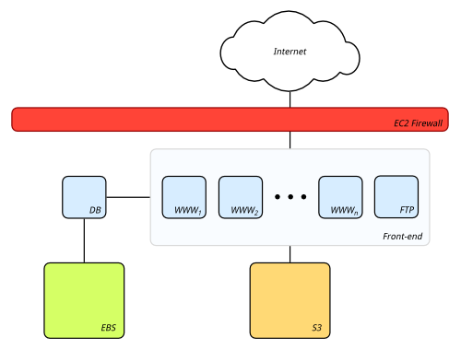
EBS and S3
Internet
EC2 Firewall

Slide 30
Database Services
SimpleDB
Relational Database Service (RDS)
Amazon Machine Image (AMI)

Slide 31
SimpleDB
Indexing Service
No Transactional Support
Non-relational Data Store
Store & Query Data Items
  Web API (REST, SOAP)
  Domains, Items, Attributes, Values
  Supports Point and Range Queries

Slide 32
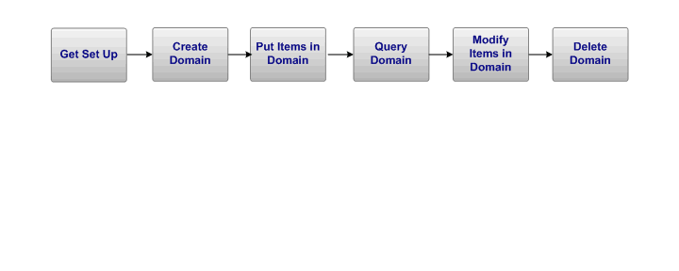
SimpleDB

Slide 33
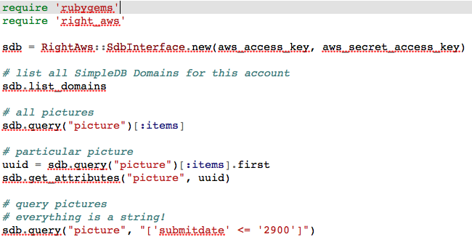
SimpleDB: Sample Queries

Slide 34
Relational Database Service (RDS)
No Maintenance, No Management
Native MySQL Support
  Port Existing Applications Easily
  Preconfigured MySQL Parameters
Synchronous Replication, Automatic Failover
  Multiple Availability Zones
  Snapshots

Slide 35
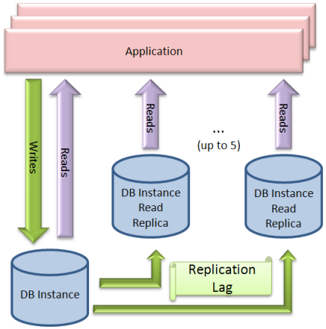
RDS: Read Replica

Slide 36
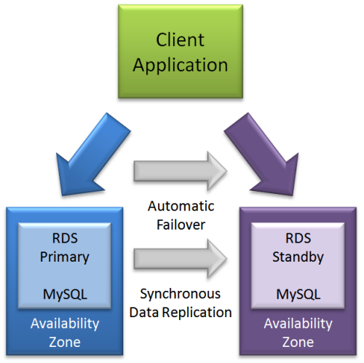
RDS: Failover

Slide 37
Amazon Machine Image (AMI)
Preconfigured Virtual Machine Instances
Databases
IBM DB2
IBM Informix Dynamic Server
Microsoft SQL Server Standard 2005/2008
MySQL Enterprise
Oracle Database 11g
ProtegeSQL
Sybase
Vertica
Batch Processing
Hadoop
Condor
Open MPI

Slide 38
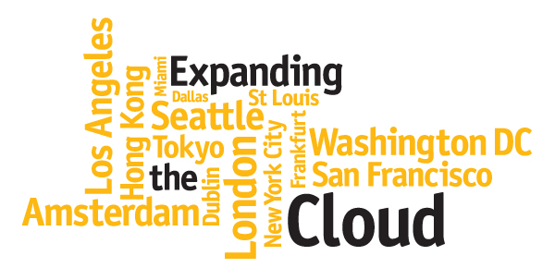
AMAZON WEB SERVICES
Integration of Services

Slide 39
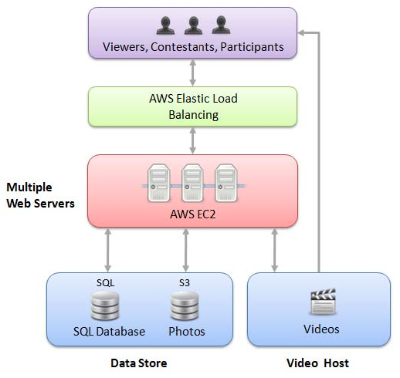
U.S. Department of State – ExchangesConnect Video Contest

Slide 40
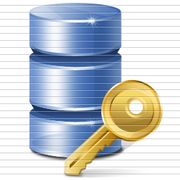
Security
Tasty Onions

Slide 41
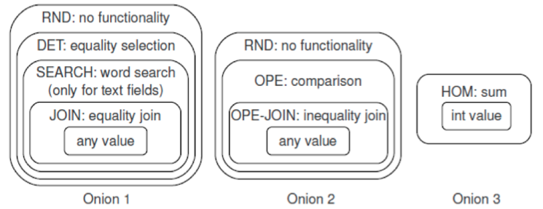
Encryption Schemes
Encryption Type | Strength and Capabilities
Randomized Encryption (RND) | Maximum Security
Deterministic Encryption (DET) | Weaker; Equality conditions
Order-Preserving Encryption (OPE) | Even weaker; Inequality, Sorting
Homomorphic Encryption (HOM) | Least Strength; Arithmetic Operations

Slide 42
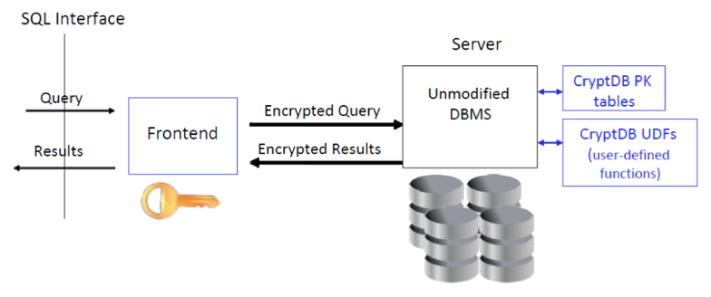
Architecture
Dataflow with Onion Security

Slide 43

DATACENTER COSTS
$ Money $

Slide 44
Pricing
Technology | Cost in Medium-sized DC | Cost in Very Large DC | Ratio
Network | $95 per Mbit/sec/month | $13 per Mbit/sec/month | 7.1
Storage | $2.20 per GB / month | $0.40 per GB / month | 5.7
Administration | ~ 140 Servers / Administrator | > 1000 Servers / Administrator | 7.1
Price per KWH | Location | Possible Reasons Why
3.6¢ | Idaho | Hydroelectric power; Transmitted short distances
10.0¢ | California | Transmitted long distances; No coal fired electricity allowed in California
18.0¢ | Hawaii | Ship fuel to generate electricity
Medium-sized datacenter = 1,000 servers; Very large datacenter = 50,000 servers

Slide 45
Revisiting Cloudy Databases
How Vital is Cloud Storage?
Shared Disk Architecture?
Why is DBaaS needed now?
Does AWS help you?
Do We Need Security?
How Security is Implemented?

Slide 46
Q & A

Slide 47
Elastic Block Storage (EBS)
Point-in-Time Snapshots
Raw, Unformatted Block Devices
  1 GB to 1 TB

Slide 48
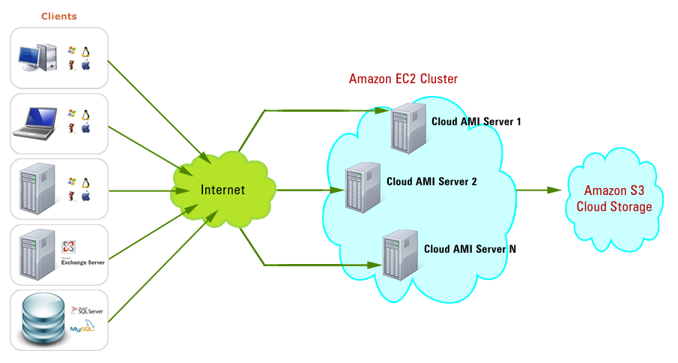
Simple Storage Service (S3)
Unlimited Object Storage
  1 B to 5 TB, per object

